Slide 1

PILOT – FriXion Ball Clicker
Mahin Karani

Slide 2
Agenda
Product Background
Strategy
Brand Character
Scenario
Creative Execution
IMC (PR)
IMC (Sales Promotion)
Summary

Slide 3
PILOT Background
Japanese naval engineers, Ryosuke Namiki and Masao Wada created the first stainless steel tipped fountain pen to stop the nibs from rusting.
The first PILOT pens were launched in 1918.
They got the name PILOT as a reference to the flagship of their naval fleet

Slide 4
FriXion Background
Original FriXion Ball was launched in 2007
FriXion Ball Clicker was launched in 2011
The ink disappears with heat and can actually reappear in the cold
Today, the Frixion lineup includes felt-tipped pens, highlighters and stamps. At the end of April, cumulative sales of the revolutionary pen topped 2 billion units. (Article published in 2017)

Slide 5

All FriXion Pens and beyond
FriXion Ball
FriXion Light
FriXion Point
FriXion Ball Clicker
FriXion Ball LX
FriXion Light Soft
FriXion Colots
FriXion Fineliner
FriXion Ball +
FriXion Zone
FriXion Point Clicker
FriXion Light Natural
Refills for the Ball and Clicker types

Slide 6
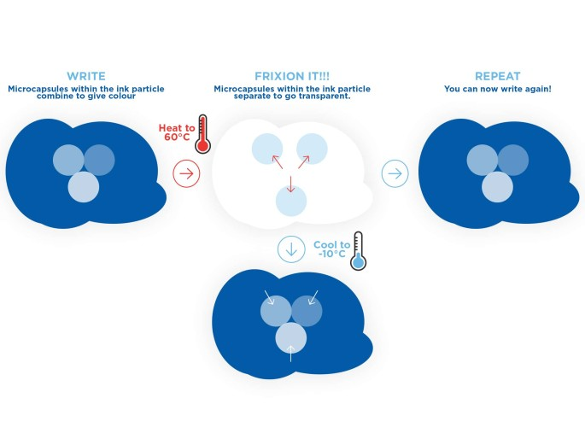
How the FriXion Pens erase

Slide 7
Target Audience for the FriXion Ball Clicker
School/College Students
Mainly targetted to age 15-22
Helps the students take notes and erase mistakes

Slide 8
Strategy (CTB)
Convince 15-22 year old students to buy the FriXion Ball Clicker because it will help them take cleaner handwritten notes with the help of the eraseable ink.

Slide 9
Brand Character
Name – Mrs. Frix (First name will be unknown)
Who is she? – Highschool Teacher, mainly science but can teach anything
Age - 42
Archetype – Ruler
Personality – Angry at everyone, gullible, doesn’t have a sense of humor

Slide 10
Mrs. Frix (Backstory)
Born in New York City 1983
  Has had severe OCD
‘Happily’ married to her highschool sweetheart for 18 years
  Not really happy anymore
Has a set of 16 year old twins who happen to be in her class
  They somehow are the cool kids at school
Obsessed with a time where a computer is only used for work
  Still pulls in a chalkboard and prints everything out for the students
Never thinks she’s wrong, because she never is
  You’ll never guess what pen she uses…
Was never on social media till her students made her accounts and still doesn’t understand it
  Her kids are part of this
  She goes around thinking everyone is stupid on the internet

Slide 11
Character Scenario
Beginning
Mrs. Frix enters her class with a stack of papers. She begins handing out the test results from last week with a D on all of them.
Students claim they deserve more than a D for giving the correct answers. She says she can’t grade what she can’t read. That’s how I was graded that’s how you will be graded.
Middle
Students decide to hatch a plan for next weeks test. They will ask each other if what they write can be read, not whether is correct or not. The students mention they wont be able to erase what they write. The Frix twins have plan.
End
Mrs. Frix is ready with her tests and the students with their plan. Mrs. Frix gets more and more annoyed giving every student detention. When she asks the students why they keep talking to each other. They say “We’re using these erasable pens to correct our mistakes so we get the grades we deserve.”

Slide 12
Scenario
Beginning
Student wants to go on a field trip with school but mom says no. Student says she has to submit the consent form even if shes not allowed to go.
Middle
Mom says okay get me a pen. Child gives her the FriXion Ball Clicker, ticks the box saying her child cannot go on this trip and signs it.
End
Child erases the pen marking and rechecks the other box saying that she can go on the trip. Mom picks her up after the trip and never finds out.

Slide 13
Creative Execution
Uploded as a separate Excel Sheet

Slide 14
IMC PR (U for Umm What?)
Have students submit a prewritten paragraph about a certain topic. The best handwriting gets turned into a font that will be used on limited edition pens and the worst gets a supply of FriXion Ball Clickers for as long as they continue their education.
Photograph of the worst handwritting featured on the back of packaging
Winner would also get a % cut of the sales from the limited edition pen
Gets as many students to participate as possible. The best get featured as part of the product, and the worst get the product itself.
Entrees accepted from January to March
Additional rules – Must be somewhat legible so it cant just be wavy lines. No intentional sabotage. 1 submission per person

Slide 15
IMC Sales Promotion (U for Umm What?)
Limited Edition FriXion Ball Clickers featuring the handwritting from the winners.
Will come with 3 pens, black, blue, winners choice, and 6 refills (2 each color)
Release around August, Back to School timing.
Potential to collaborate with other stationary/school equipment products or even the other types of pens that Pilot makes

Slide 16
Summary
Mrs. Frix as a character seems either relatable or comedic to students. Especially in her future using social media to react to students online
The other scenario, while a lot simpler, could also end up working well since around 15-17 is when students wish they had the freedom to do whatever and could even make the 18-22 year olds feel nostalgic about when their problems were because mom said no.
The ‘U for Umm What?’ encourages participation from all students and has a reasonable rewards for both ‘winners’ involved.

